Slide 1
CS2009 Design and Analysis of Algorithms
Geometric Algorithms

Slide 2
Operations
primitive operations
convex hull
closest pair

Slide 3
Applications
VLSI design
Computer vision
Mathematical models
Astronomical simulation
Geographic information systems
Computer graphics (movies, games, virtual reality)
Models of physical world (maps, architecture, medical imaging).

Slide 4
Point: two numbers (x, y)
Line: two numbers a and b [ax + by = 1]
Line segment: two points
Polygon: sequence of points

Slide 5
Primitive operations
Is a point inside a polygon?
Compare slopes of two lines
Distance between two points
Do two line segments intersect?
Given three points p1, p2, p3, is p1-p2-p3 a counterclockwise turn?

Slide 6
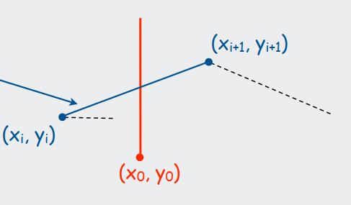
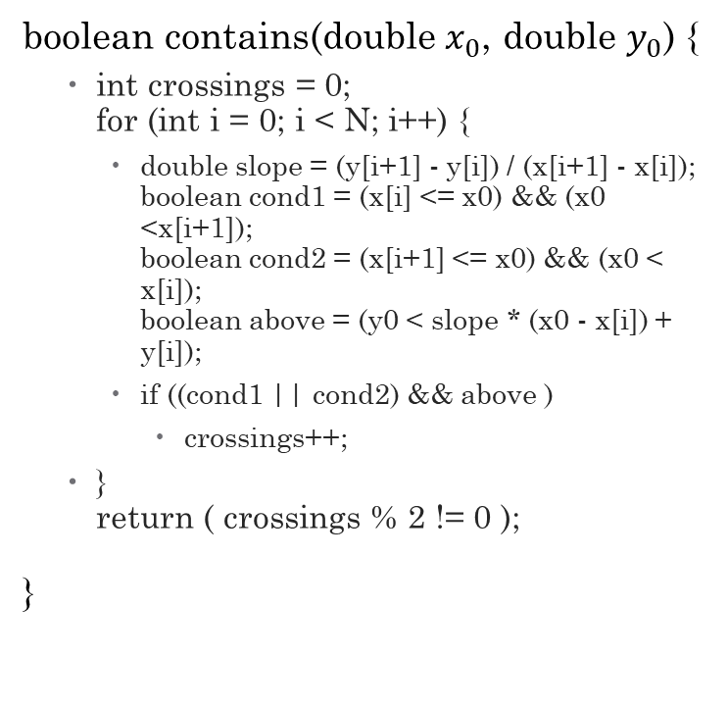

Does line segment intersect ray?
$Y=\frac{Y_{i+1}−Y_{i}}{X_{i+1}−X_{i}}\left(X_{0}−X_{i}\right)+Y_{i}$
$x_{i}≤x_{0}≤x_{i+1}$
boolean contains(double $x_{0}$, double $y_{0}$) {
int crossings = 0; for (int i = 0; i < N; i++) {
double slope = (y[i+1] - y[i]) / (x[i+1] - x[i]); boolean cond1 = (x[i] <= x0) && (x0 <x[i+1]); boolean cond2 = (x[i+1] <= x0) && (x0 < x[i]); boolean above = (y0 < slope * (x0 - x[i]) + y[i]);
if ((cond1 || cond2) && above )
crossings++;
} return ( crossings % 2 != 0 );
}

Slide 7
Implementing CCW
CCW. Given three point a, b, and c, is a-b-c a counterclockwise turn?
• Analog of comparisons in sorting.
• Idea: compare slopes.
Lesson. Geometric primitives are tricky to implement.
• Dealing with degenerate cases.
• Coping with floating point precision.
Implementing CCW

Slide 8
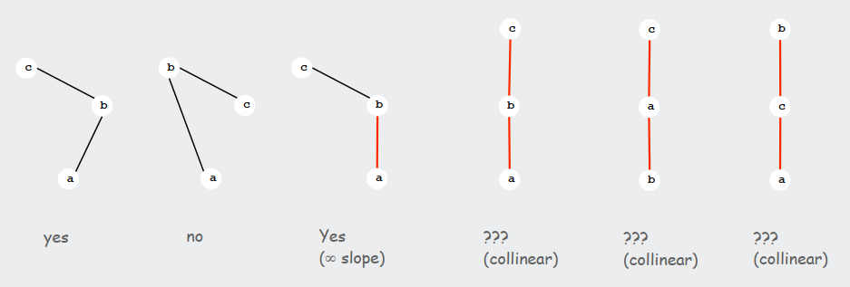
Implementing CCW…

Slide 9
CCW: Implementation
CCW. Given three point a, b, and c, is a-b-c a counterclockwise turn?
Determinant gives twice area of triangle.
If area > 0 then a-b-c is counterclockwise.
If area < 0, then a-b-c is clockwise.
If area = 0, then a-b-c are collinear.

Slide 10
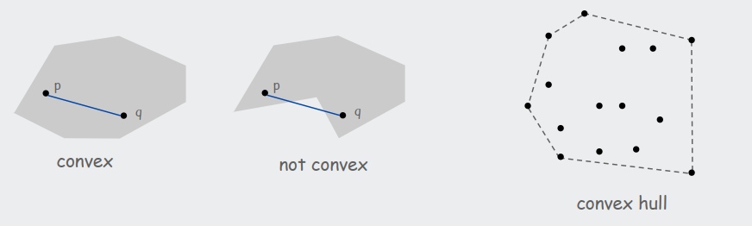
Convex Hull
A set of points is convex if for any two points p and q in the set, the line segment pq is completely in the set.
Convex hull. Smallest convex set containing all the points.
Properties
"Simplest" shape that approximates set of points.
Shortest (perimeter) fence surrounding the points.
Smallest (area) convex polygon enclosing the points.

Slide 11
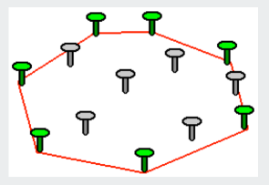
Mechanical algorithm
Hammer nails perpendicular to plane;
stretch elastic rubber band around points

Slide 12
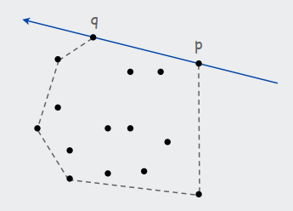
Brute-force algorithm
Observation 1:
Edges of convex hull of P connect pairs of points in P.
Observation 2
p-q is on convex hull if all other points are counterclockwise of pq.
O(N3) algorithm
For all pairs of points p and q in P
compute ccw(p, q, x) for all other x in P
p-q is on hull if all values positive

Slide 13
Package Wrap (Jarvis March)
Package wrap
Start with point with smallest y-coordinate.
Rotate sweep line around current point in ccw direction.
First point hit is on the hull.
Repeat.

Slide 14
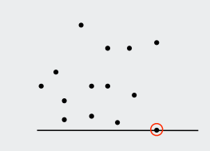
Package Wrap
Algorithm
Execution
Start with point with smallest y-coordinate.
Rotate sweep line around current point in ccw direction.
First point hit is on the hull.
Repeat.

Slide 15
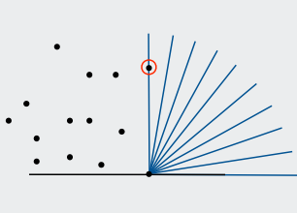
Package Wrap
Algorithm
Execution
Start with point with smallest y-coordinate.
Rotate sweep line around current point in ccw direction.
First point hit is on the hull.
Repeat.

Slide 16
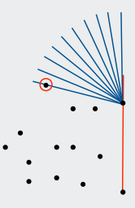
Package Wrap
Algorithm
Execution
Start with point with smallest y-coordinate.
Rotate sweep line around current point in ccw direction.
First point hit is on the hull.
Repeat.

Slide 17
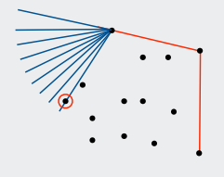
Package Wrap
Algorithm
Execution
Start with point with smallest y-coordinate.
Rotate sweep line around current point in ccw direction.
First point hit is on the hull.
Repeat.

Slide 18
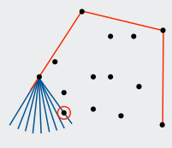
Package Wrap
Algorithm
Execution
Start with point with smallest y-coordinate.
Rotate sweep line around current point in ccw direction.
First point hit is on the hull.
Repeat.

Slide 19
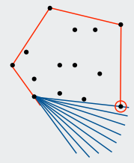
Package Wrap
Algorithm
Execution
Start with point with smallest y-coordinate.
Rotate sweep line around current point in ccw direction.
First point hit is on the hull.
Repeat.

Slide 20

Package Wrap
Implementation.
Compute angle between current point and all remaining points.
Pick smallest angle larger than current angle.
$Θ(N)$ per iteration.

Slide 21
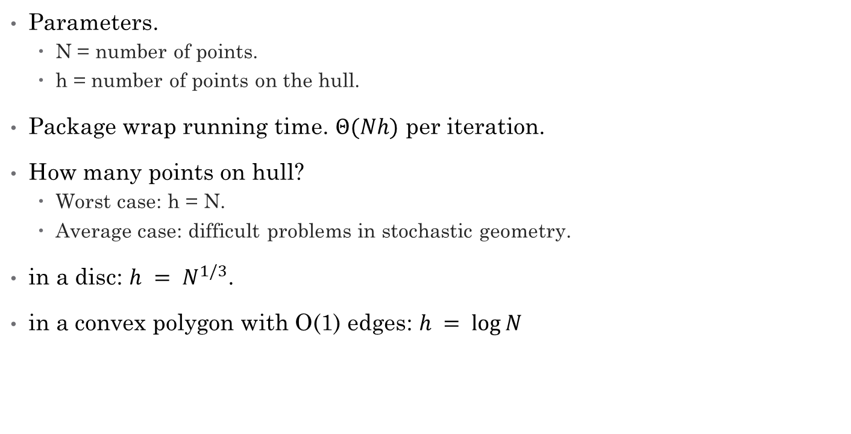
How Many Points on the Hull?
Parameters.
N = number of points.
h = number of points on the hull.
Package wrap running time. $Θ(Nh)$ per iteration.
How many points on hull?
Worst case: h = N.
Average case: difficult problems in stochastic geometry.
in a disc: $h = N^{1/3}$.
in a convex polygon with O(1) edges: $h = log⁡N$

Slide 22
Graham Scan

Slide 23
Graham scan
Choose point p with smallest y-coordinate.
Sort points by polar angle with p.
Consider points in order, and discard unless that would create a ccw turn.
p

Slide 24
Graham scan
Choose point p with smallest y-coordinate.
Sort points by polar angle with p.
Consider points in order, and discard unless that would create a ccw turn.
6
5
2
3
9
10
8
7
4
11
13
14
12
1

Slide 25
Graham scan
Choose point p with smallest y-coordinate.
Sort points by polar angle with p.
Consider points in order, and discard unless that would create a ccw turn.
6
5
2
3
9
10
8
7
4
11
13
14
12
1

Slide 26
Graham scan
Choose point p with smallest y-coordinate.
Sort points by polar angle with p.
Consider points in order, and discard unless that would create a ccw turn.
6
5
2
3
9
10
8
7
4
11
13
14
12
1

Slide 27
Graham scan
Choose point p with smallest y-coordinate.
Sort points by polar angle with p.
Consider points in order, and discard unless that would create a ccw turn.
6
5
2
3
9
10
8
7
4
11
13
14
12
1

Slide 28
Graham scan
Choose point p with smallest y-coordinate.
Sort points by polar angle with p.
Consider points in order, and discard unless that would create a ccw turn.
6
5
2
3
9
10
8
7
4
11
13
14
12
1

Slide 29
Graham scan
Choose point p with smallest y-coordinate.
Sort points by polar angle with p.
Consider points in order, and discard unless that would create a ccw turn.
6
5
2
3
9
10
8
7
4
11
13
14
12
1

Slide 30
Graham scan
Choose point p with smallest y-coordinate.
Sort points by polar angle with p.
Consider points in order, and discard unless that would create a ccw turn.
6
5
2
3
9
10
8
7
4
11
13
14
12
1

Slide 31
Graham scan
Choose point p with smallest y-coordinate.
Sort points by polar angle with p.
Consider points in order, and discard unless that would create a ccw turn.
6
5
2
3
9
10
8
7
4
11
13
14
12
1

Slide 32
Graham scan
Choose point p with smallest y-coordinate.
Sort points by polar angle with p.
Consider points in order, and discard unless that would create a ccw turn.
6
5
2
3
9
10
8
7
4
11
13
14
12
1

Slide 33
Graham scan
Choose point p with smallest y-coordinate.
Sort points by polar angle with p.
Consider points in order, and discard unless that would create a ccw turn.
6
5
2
3
9
10
8
7
4
11
13
14
12
1

Slide 34
Graham scan
Choose point p with smallest y-coordinate.
Sort points by polar angle with p.
Consider points in order, and discard unless that would create a ccw turn.
6
5
2
3
9
10
8
7
4
11
13
14
12
1

Slide 35
Graham scan
Choose point p with smallest y-coordinate.
Sort points by polar angle with p.
Consider points in order, and discard unless that would create a ccw turn.
6
5
2
3
9
10
8
7
4
11
13
14
12
1

Slide 36
Graham scan
Choose point p with smallest y-coordinate.
Sort points by polar angle with p.
Consider points in order, and discard unless that would create a ccw turn.
6
5
2
3
9
10
8
7
4
11
13
14
12
1

Slide 37
Graham scan
Choose point p with smallest y-coordinate.
Sort points by polar angle with p.
Consider points in order, and discard unless that would create a ccw turn.
6
5
2
3
9
10
8
7
4
11
13
14
12
1

Slide 38
Graham scan
Choose point p with smallest y-coordinate.
Sort points by polar angle with p.
Consider points in order, and discard unless that would create a ccw turn.
6
5
2
3
9
10
8
7
4
11
13
14
12
1

Slide 39
Graham scan
Choose point p with smallest y-coordinate.
Sort points by polar angle with p.
Consider points in order, and discard unless that would create a ccw turn.
6
5
2
3
9
10
8
7
4
11
13
14
12
1

Slide 40
Graham scan
Choose point p with smallest y-coordinate.
Sort points by polar angle with p.
Consider points in order, and discard unless that would create a ccw turn.
6
5
2
3
9
10
8
7
4
11
13
14
12
1

Slide 41
Graham scan
Choose point p with smallest y-coordinate.
Sort points by polar angle with p.
Consider points in order, and discard unless that would create a ccw turn.
6
5
2
3
9
10
8
7
4
11
13
14
12
1

Slide 42
Graham scan
Choose point p with smallest y-coordinate.
Sort points by polar angle with p.
Consider points in order, and discard unless that would create a ccw turn.
6
5
2
3
9
10
8
7
4
11
13
14
12
1

Slide 43
Graham scan
Choose point p with smallest y-coordinate.
Sort points by polar angle with p.
Consider points in order, and discard unless that would create a ccw turn.
6
5
2
3
9
10
8
7
4
11
13
14
12
1

Slide 44
Graham scan
Choose point p with smallest y-coordinate.
Sort points by polar angle with p.
Consider points in order, and discard unless that would create a ccw turn.
6
5
2
3
9
10
8
7
4
11
13
14
12
1

Slide 45
Graham scan
Choose point p with smallest y-coordinate.
Sort points by polar angle with p.
Consider points in order, and discard unless that would create a ccw turn.
6
5
2
3
9
10
8
7
4
11
13
14
12
1

Slide 46
Graham scan
Choose point p with smallest y-coordinate.
Sort points by polar angle with p.
Consider points in order, and discard unless that would create a ccw turn.
6
5
2
3
9
10
8
7
4
11
13
14
12
1

Slide 47
Graham scan
Choose point p with smallest y-coordinate.
Sort points by polar angle with p.
Consider points in order, and discard unless that would create a ccw turn.
6
5
2
3
9
10
8
7
4
11
13
14
12
1

Slide 48
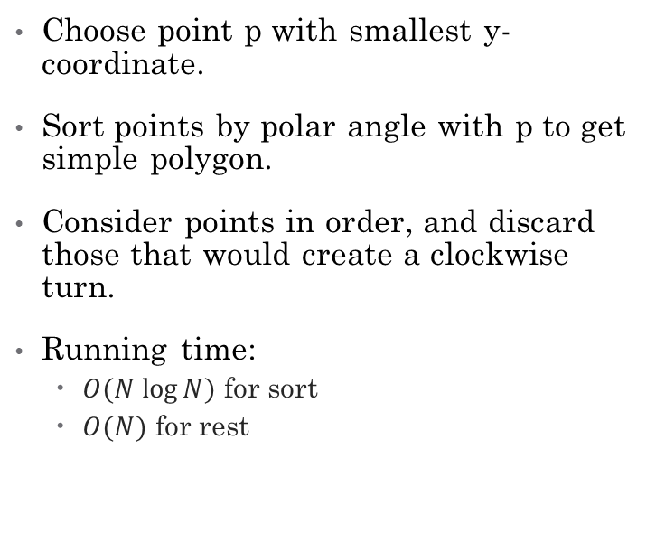
Graham Scan
Algorithm
Implementation
Choose point p with smallest y-coordinate.
Sort points by polar angle with p to get simple polygon.
Consider points in order, and discard those that would create a clockwise turn.
Running time:
$O(N log⁡N)$ for sort
$O(N)$ for rest
preprocess so that p[1] has smallest y-coordinate
sort by angle with p[1]
points[0] = points[N]; // sentinel
int M = 2;
for (int i = 3; i <= N; i++) {
while (Point.ccw(p[M-1], p[M], p[i]) <= 0)
M--;
M++;
swap(points, M, i);
}

Slide 49
Quick Elimination
Choose a quadrilateral Q or rectangle R with 4 points as corners.
Any point inside cannot be on hull
4 ccw tests for quadrilateral
4 comparisons for rectangle

Slide 50
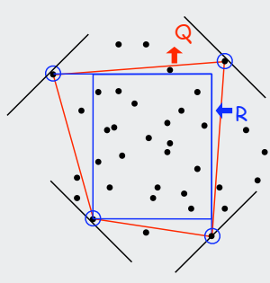
Quick Elimination
Three-phase algorithm
Pass through all points to compute R.
Eliminate points inside R.
Find convex hull of remaining points.

Slide 51
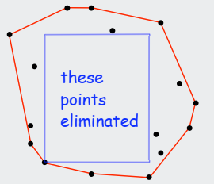
Quick Elimination
In practice
can eliminate almost all points in linear time.

Slide 52
Comparison
Sr. No. | algorithm | growth of running time
1 | Package wrap | NH
2 | Graham scan | NlogN
3 | Quick elimination | N+
N is the number of total points
H is the number of points at Hull

Slide 53
CS2009 Design and Analysis of Algorithms
Closest pair

Slide 54
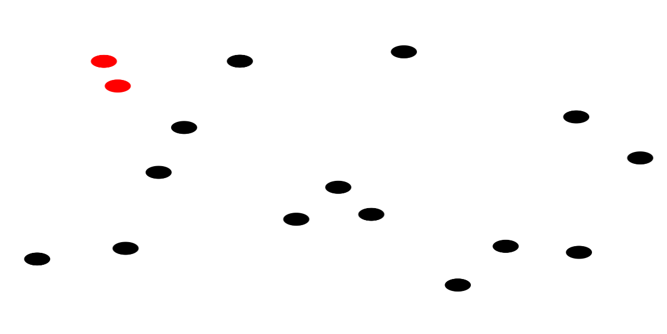
Closest pair problem
Closest Pair Problem :
Given a set of points, we need to find a pair of points where distance between those two points is minimum than distance between any other pair of points.

Slide 55
Closest Pair Problem
Applications :
Collision detection
Hierarchical Clustering
Straight skeleton and roof design
and many more

Slide 56
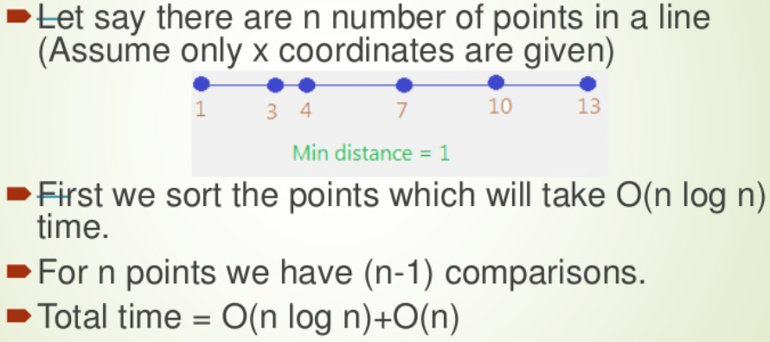
Closest Pair Problem
1-dimension : It is easy to find closest pair in O(nlogn) time if points are in 1-dimension.
Example:

Slide 57

Closest Pair Problem
If points are in 2-dimension then we can use Euclidian Distance to find distance between two points
Euclidian distance : $dist\left(P_{1},P_{2}\right)=\sqrt{{\left(P_{1x}−P_{2x}\right)}^{2}+{\left(P_{1y}−P_{2y}\right)}^{2}}$

Slide 58


Closest Pair Problem
Brute Force Approach
Algorithm
We can use nested for loops to calculate distance (through Euclidian distance formula) between every pair of points and can return minimum at the end.
$$T\left(n\right)=O(n^{2})$$
$for i∈S$
$for j∈S∧i≠j$
$d=d(i,j)$
$d_{min}=d_{min}<d?d_{min}:d$
$return d_{min}$

Slide 59
Closest Pair Problem
Divide and Conquer Strategy
Algorithm
It finds closest pair in O(nlogn) time if points are in two dimension.
We apply divide and conquer strategy by first finding the median so that points can be partitioned across median value in two halves. Median sorts the points according to their x coordinate and then partition them equally. So algorithm works as follows :
Divide int two equal
Solve the sub-problems
Merge the solution

Slide 60
Closest Pair Problem
First we need to partition points based on median of x-coordinate values of all points.
For example, if we have points (2,3),(5,4),(1,6),(3,2) then to find median based on x-coordinate values , first sort values :
X-coordinate values = 2,5,1,3
After sorting = 1,2,3,5
If total number of values are odd then median is middle value. If even then median is the average of two middle values. Here the total values are 4 which is even so :
Median = (2+3)/2 = 2.5 (So we need to draw vertical partition line at x=3.5 that will divide total points in two halves.

Slide 61
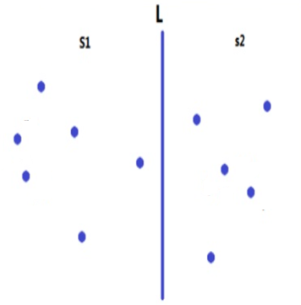
Closest Pair Problem
Partition Line

Slide 62
Closest Pair Problem
Then we need to find :
Closest pair in left half
Closest pair in right half
Closest pair across partition line
Then we can take minimum of three which will give us closest pair of points

Slide 63
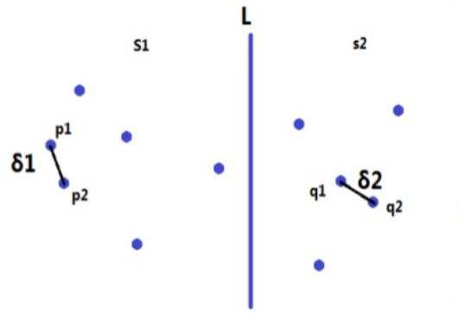
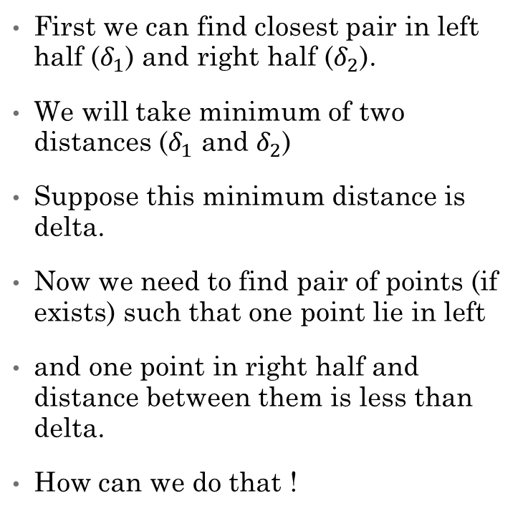
Closest Pair Problem
First we can find closest pair in left half ($δ_{1}$) and right half ($δ_{2}$).
We will take minimum of two distances ($δ_{1}$ and $δ_{2}$)
Suppose this minimum distance is delta.
Now we need to find pair of points (if exists) such that one point lie in left
and one point in right half and distance between them is less than delta.
How can we do that !

Slide 64
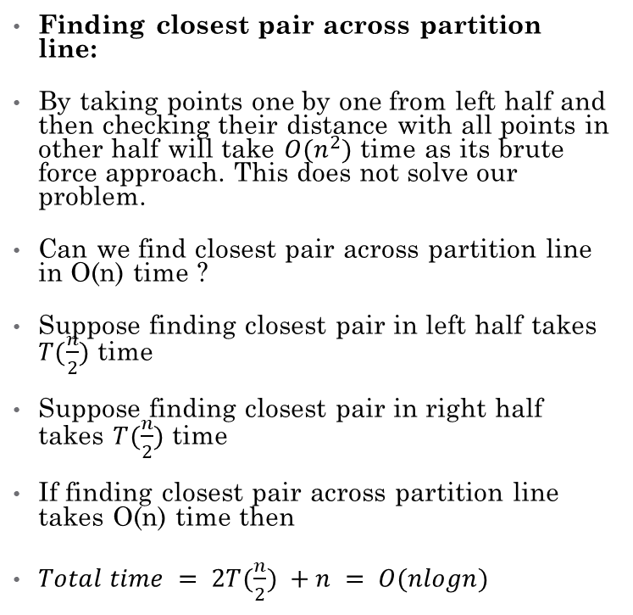
Closest Pair Problem
Finding closest pair across partition line:
By taking points one by one from left half and then checking their distance with all points in other half will take $O(n^{2})$ time as its brute force approach. This does not solve our problem.
Can we find closest pair across partition line in O(n) time ?
Suppose finding closest pair in left half takes $T(\frac{n}{2})$ time
Suppose finding closest pair in right half takes $T(\frac{n}{2})$ time
If finding closest pair across partition line takes O(n) time then
$Total time = 2T(\frac{n}{2}) +n = O(nlogn)$

Slide 65
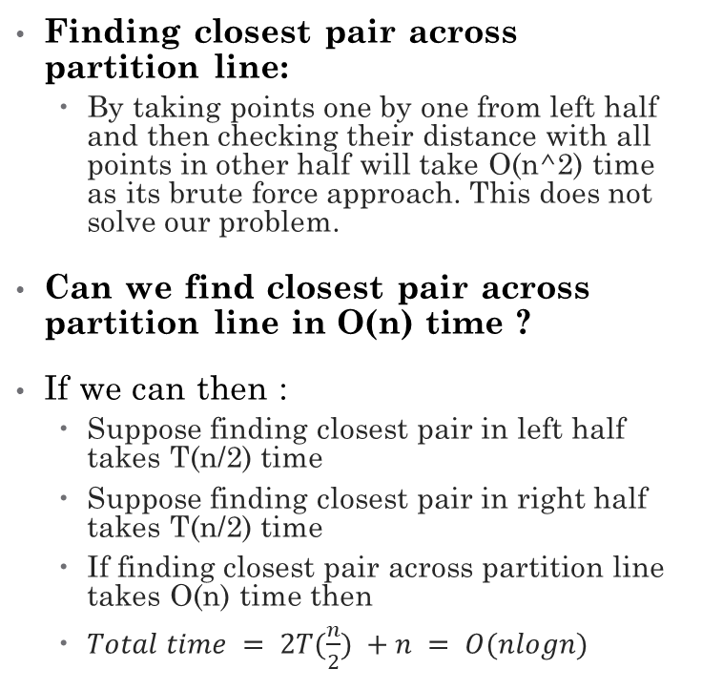
Closest Pair Problem
Finding closest pair across partition line:
By taking points one by one from left half and then checking their distance with all points in other half will take O(n^2) time as its brute force approach. This does not solve our problem.
Can we find closest pair across partition line in O(n) time ?
If we can then :
Suppose finding closest pair in left half takes T(n/2) time
Suppose finding closest pair in right half takes T(n/2) time
If finding closest pair across partition line takes O(n) time then
$Total time = 2T(\frac{n}{2}) +n = O(nlogn)$

Slide 66
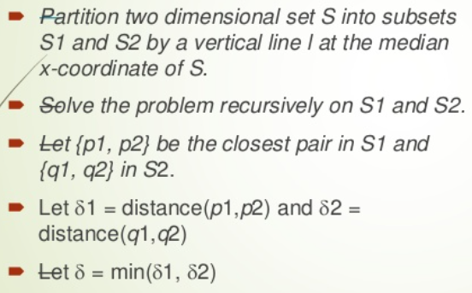
Closest Pair Problem
We have done this till now :

Slide 67
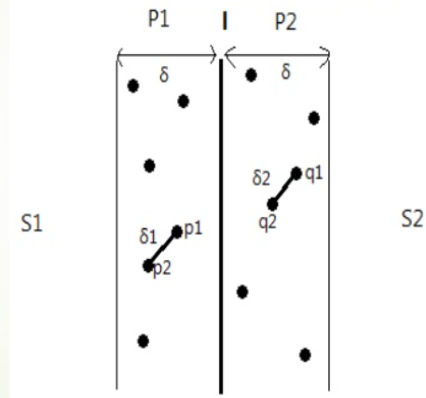
Closest Pair Problem
Approach of finding closest pair across partition line in O(n) time :
We have already got one closest pair from left and right half (delta).
Now we are only interested in closest pairs across partition line having distance less than delta.
So instead of considering all points, take only those points from left and right half that are at a distance of delta from partition line.

Slide 68
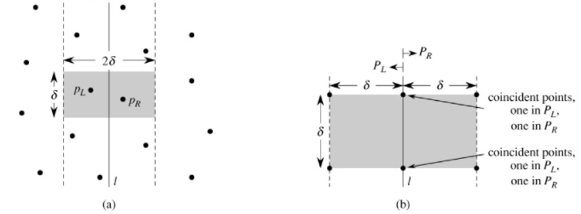
Closest Pair Problem
If we are taking any point (across partition line) to start comparing then there could be at most 4 points in one half that could be at most delta distance apart from that point. 4 points for other half so total 8 points. We do not need to compare it with remaining points as those will be more than delta distance apart from that point.
consider PL and PR in this figure as P1 and P2 respectively (left and right half)

Slide 69
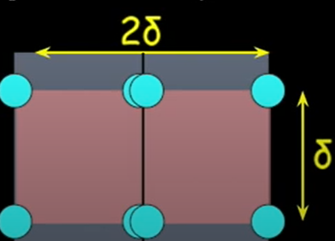
Closest Pair Problem
To get a more clear view of those 8 points that we need to compare with :
If we compare every point with its next 7 points only then total operations = 7n = O(n)

Slide 70
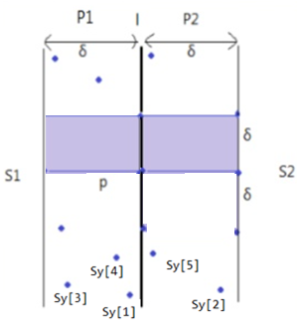
Closest Pair Problem
Let “Sy” is array that contains all the points of P1 and P2
in ascending order of y coordinate. Like in diagram, these points
will be labeled as ( Sy[1], Sy[2], Sy[3],.…,Sy[n] )
Then we need to compare first point of Sy known as “Sy[1]” with
next 7 points “Sy[2], Sy[3], Sy[4], Sy[5], Sy[6],Sy[7],Sy(8) “ and find distance
with each seven points to check if it is less than . If it is then update .
We do not need to check distance with 8th point and onwards
because it will be greater than .
After that, we will take second point of Sy known as “Sy[2]”
and will compare it with next seven points“Sy[3], Sy[4], Sy[5],….,Sy[9]” and this will go on till we
iterate each point of Sy. So these will be total 7n operations = O(n)

Slide 71
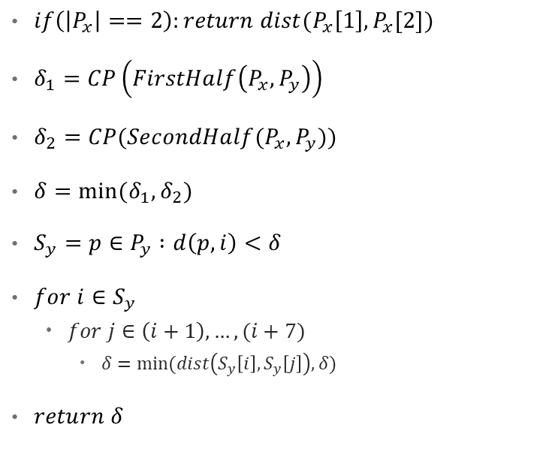
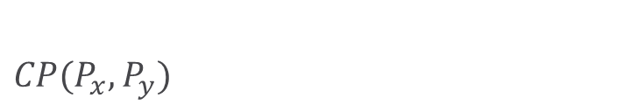
Closest Pair Problem
$CP(P_{x}, P_{y})$
Example
$if\left(\left|P_{x}\right|==2\right):return dist(P_{x}\left[1\right],P_{x}[2])$
$δ_{1}=CP\left(FirstHalf\left(P_{x},P_{y}\right)\right)$
$δ_{2}=CP(SecondHalf(P_{x},P_{y}))$
$δ=min⁡(δ_{1},δ_{2})$
$S_{y}=p∈P_{y} :d\left(p,i\right)<δ$
$for i∈S_{y}$
$for j∈\left(i+1\right),…,(i+7)$
$δ=min⁡(dist\left(S_{y}\left[i\right],S_{y}\left[j\right]\right),δ)$
$return δ$

Slide 72
Closest Pair Problem
Time Complexity :
Time to find closest pair in left half = T(n/2)
Time to find closest pair in right half = T(n/2)
Time to find closest pair across partition = 6n = O(n)
Total time = 2T(n/2) + n = O(nlogn)

